Slide 1
DOM and SAX

Slide 2
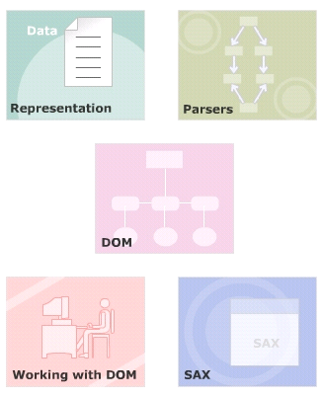
Module Introduction
Welcome to the module,
Introduce the various models of viewing a document such as linear, tree and object model.
Discusses about the concept of parsing and its various techniques.
Explain the concept of Document Object Model (DOM)
Introduction to using SAX parsing
In this module, you will learn about:
  Representing Data
  Parsers
  DOM
  Working with DOM
  SAX

Slide 3
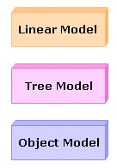
Models
Way of representing data or information.
The data within XML documents can be represented using various models.
Linear model
Tree model
Object model

Slide 4
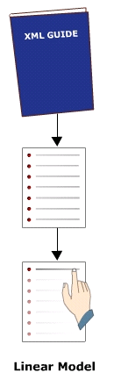
Linear Model
The linear model can be applied to a static document object, such as book.
To go to a particular topic in a book information required is:
  The book name
  Page number
  The line number on that page

Slide 5
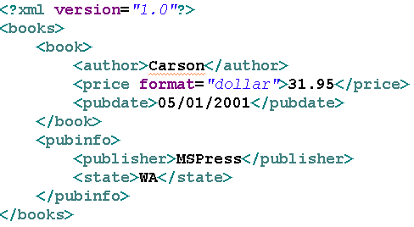
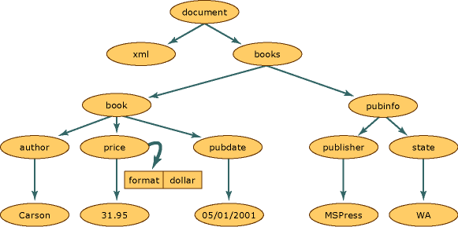
Tree Model
Hierarchical structure which can be interpreted as a tree structure
The tree structure helps to identify children with their parents.
The model is best suited for dynamic documents.

Slide 6
Object Model
Collection of objects that is used to access and manipulate the data stored in an XML document.
Each element in the tree is considered a node that contains the data in the document
Objects with various properties and methods are used to traverse the tree and its nodes..
The W3C DOM API provides a set of excellent methods to build complex documents.

Slide 7
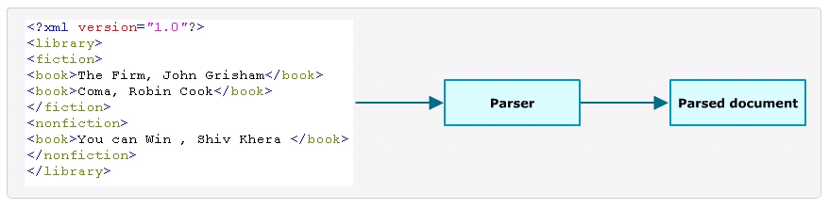
Parsers
Is a software package, a library or a module.
XML Parser:
  Reads XML documents
  Checks for the well-formedness and validity of the document,
  Made XML data available for further process

Slide 8
Parsing Techniques
Event-driven parsing
Object-based parsing
  The XML document is read by the parser in the memory.
  Representing the document it builds in-memory data structures that can be navigated.
  Document Object Model (DOM) performs object-based parsing.

Slide 9
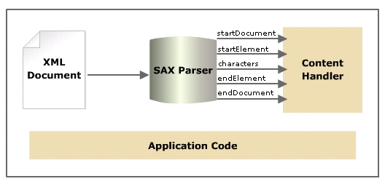
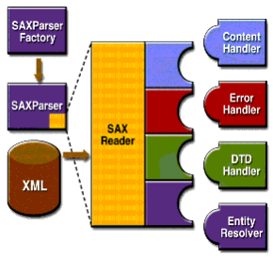
Event-driven parsing
The XML document is read in a sequential order.
Each time it parses a significant amount of document such as an element, it makes a call to the application.
Simple API for XML (SAX) performs event-driven parsing.

Slide 10
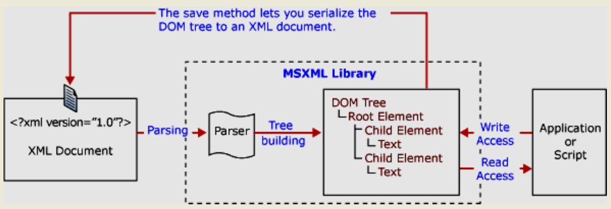
Object-based parsing
The XML document is read by the parser in the memory.
Representing the document it builds in-memory data structures that can be navigated.
Document Object Model (DOM) performs object-based parsing.

Slide 11
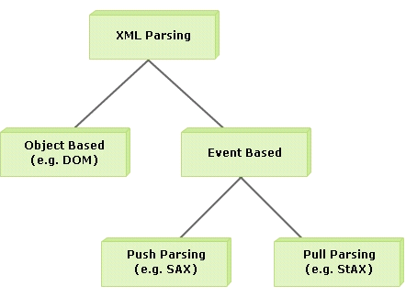
Types of Parsers
Simple API for XML (SAX)
  event based approach to XML parsing.
Document Object Model (DOM)
  DOM parser builds a hierarchical model of the parsed document
Streaming API for XML (StAX)
  new parsing model
  event-driven model like SAX but uses pull model for event processing.

Slide 12
Introduction to DOM
Document Object Model (DOM) is an approach by which a document is treated as an object
DOM is a W3C standard.
W3C DOM is an interface independent of platform and language.
DOM accesses programs and scripts dynamically and allows the updation of the content, structure and style of the document.
Provides standard interface for accessing and manipulating XML documents.
W3C DOM is separated into different parts.
  Core DOM
  XML DOM
  HTML DOM.

Slide 13
DOM Objects
All elements present in the XML document including their contents is accessed using the DOM tree.
DOM considers all items present in an XML document as node.
There is a hierarchical relationship between nodes.

Slide 14
DOM Objects
Node tree represents an XML document as a set of nodes and the relationship between them.
  The top node represents the root.
  A node has one parent node except root.
  A node can have many children.
  A node with no child node is known as the leaf node.
  Nodes having same parent node are known as siblings.

Slide 15
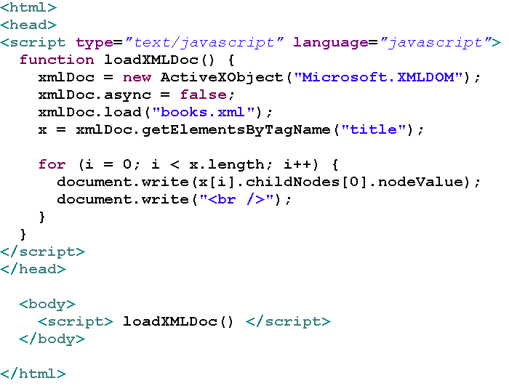
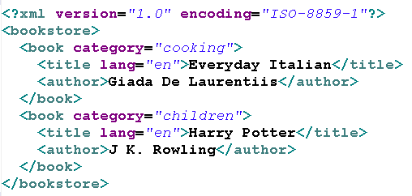
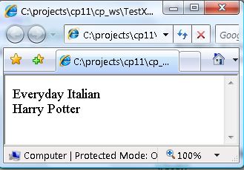
Creation of XML Document Object

Slide 16
Simple API for XML (SAX)
SAX is a standard interface for event-based XML parsing
Developed by members of the XML-DEV mailing list

Slide 17
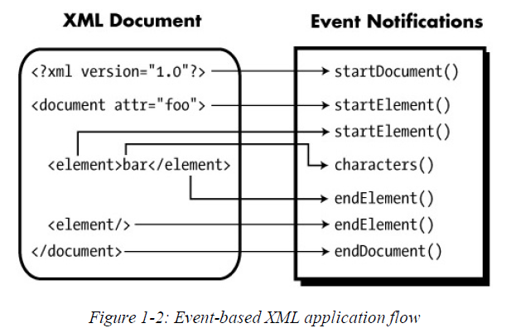
How SAX event-based XML parsing work?

Slide 18
XML Parsing using SAX
SAX generates events as it reads through the document
The event handlers handle these events
ContentHandler
  Interface, use for accessing the contents of the XML document.
DefauItHandler
  org.xml.sax.helpers.DefaultHandler class
  Implements ContentHandler, ErrorHandler, EntityResolver, and DTDHandler interface
XMLReader
  Interface, allows an application to
    Set and retrieve features and properties in the parser
    Register event handlers
    To begin parsing of a document.

Slide 19
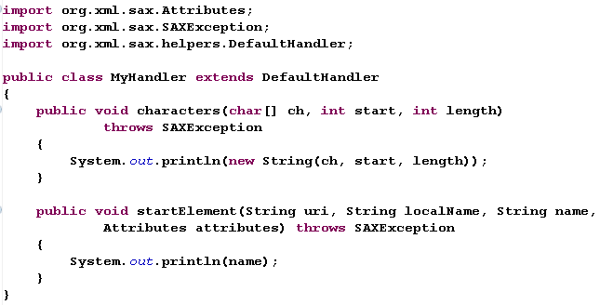
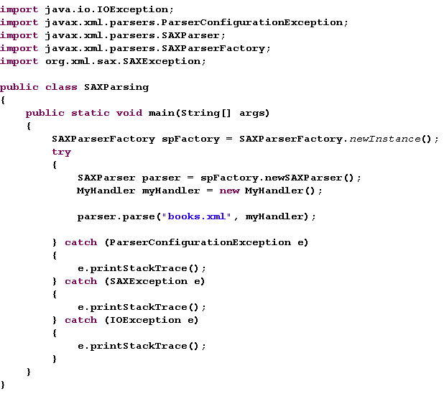
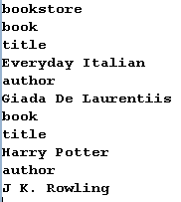

Slide 20
That’s about all for today!
Representing Data
Parsers
DOM - Working with DOM
SAX
Thank you all for your attention and patient !

